Slide 1

Data Science Building Models
Facultad de Ciencias Económicas
Catedrático: Franz Haidacher

Slide 2
Building Models
All-in
Backward Elimination
Forward Selection
Bidirectional Elimination
Score Comparison (all models)
Stepwise Regression

Slide 3

All-in
You have to
Prior knowledge
Preparing for backward elimination

Slide 4
Backward Elimination
Select a significance level to stay in the model (e.g. SL = 0.05)
Fit the full model with all possible predictors
Consider the predictor with highest P-value. If P > SL then goto step 4, else end.
Remove the predictor
Fit model without this variable

Slide 5
Forward Selection
Select a significance level to enter in the model (e.g. SL = 0.05)
Fit all simple regression models. Select the one with the lowest P-value.
Keep this variable and fit all possible models with one extra predictor, in addition to the existing one(s).
Consider the predictor with the lowest P-value. If P<SL then goto step 3, else goto step 5.
Keep the previous model.

Slide 6
Bidirectional Elimination
Select a significance level to enter and to stay in the model (e.g. SL = 0.05)
Perform the next step of Forward Selection (new variables must have P<SL to enter)
Perform ALL steps of Backward Elimination (old variables must have P<SL to stay)
No new variables can enter and no old variables can exit.

Slide 7
All possible models
Select acceptance criteria for fit (e.g. Akaike information criterion)
Construct all possible regression models (2^{n}-1 total combinations)
Select the one with the best criterion.

Slide 8
Multiple Linear Regression
y = b₀ + b₁*x₁ + b₂*x₂ + … + b_{n}*x_{n}
y: dependent variable
b₀: constant
b_{i}: coefficients
x_{i}: independent variables

Slide 9
Example:
Choose and rank the most significant predictor variables for success in a Data Science (DS) contest …
Years of work experience in DS
Amount of RAM memory in his/her computer
Connections to DS professionals on LinkedIn
Amount of DS certifications taken
Amount of original DS articles published
Amount of T-shirts collected from DS conventions
Uses eyeglasses
Is blond
Amount of Kaggle competitions as participant
Owns and iPhone

Slide 10
And the result is:
Choose and rank the most significant predictor variables for success in a Data Science (DS) contest …
Amount of Kaggle competitions as participant
Amount of original DS articles published
Amount of DS certifications taken
Connections to DS professionals on LinkedIn
Years of work experience in DS
Amount of T-shirts collected from DS conventions
Amount of RAM memory in his/her computer
Uses eyeglasses
Owns and iPhone
Is blond

Slide 11

Machine Learning Algorithms

Slide 12
Steps to build a model
Get data
Clean data
Determine the problem (Scikit-learn decision tree)
Choose variables
?

Slide 13
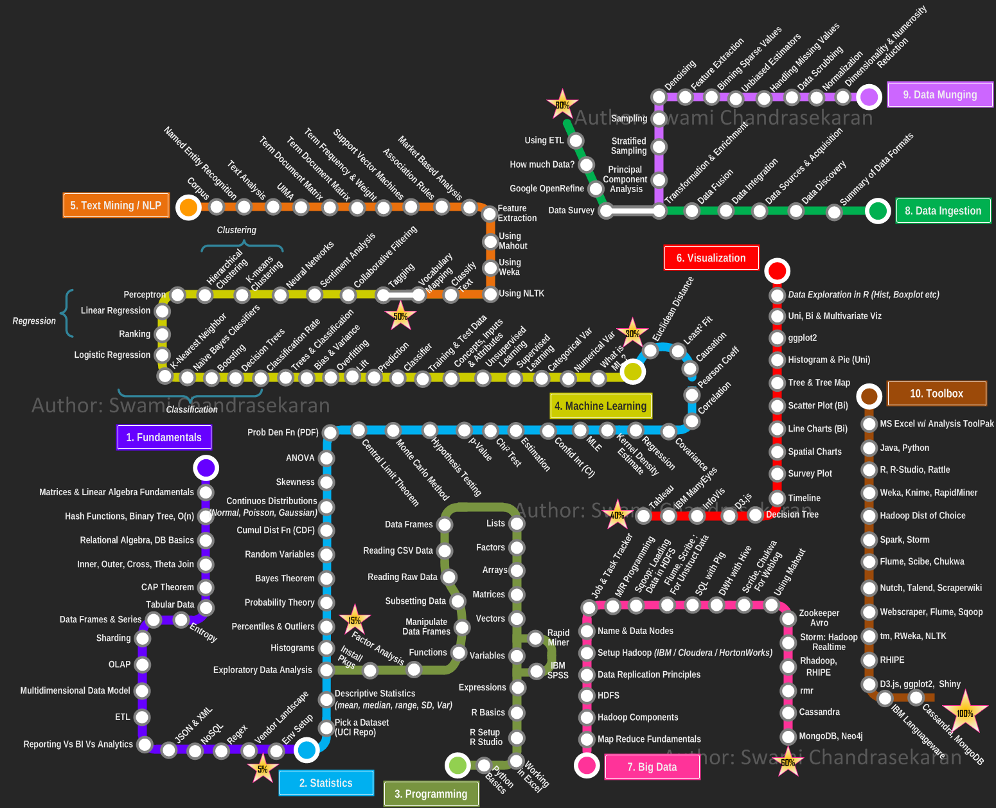

Slide 14
